Slide 1
Lean/Design Six Sigma Green Belt
Project title

Slide 2

Project Team Structure
Support Personnel
Business function
Xxxxx
Xxxxx
Business function
Xxxxx
Xxxxx
Business function
Xxxxx
Xxxxx
Xxx
(Project sponsor)
Xxx (Champion)
Xxx (Project leader)
Xxx (Team member)
Xxx (Team member)

Slide 3
Define
Measure
Analyze
Improve
Control
Introduction
Project scope & Time Plan
Cost Benefits
Risks and Mitigation Action
SIPOC / Functional Block Diagram
Critical to Requirement (CTR) / Critical to Quality (CTQ)

Slide 4
Define
Measure
Analyze
Design
Verify
Introduction
Project scope & Time Plan
Cost Benefits
Risks and Mitigation Action
SIPOC / Functional Block Diagram
Critical to Requirement (CTR) / Critical to Quality (CTQ)

Slide 5
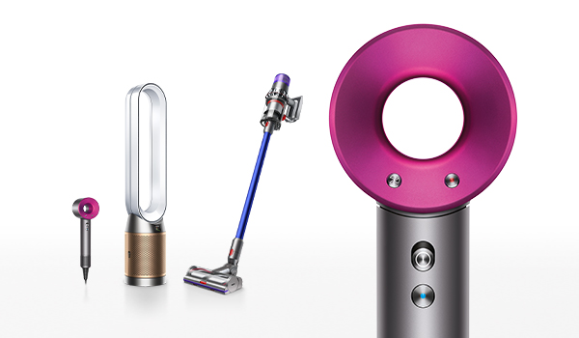
Introduction
Define
Measure
Analyze
Improve
Control
Business case
Add text
Project opportunity
Add picture
Add text

Slide 6
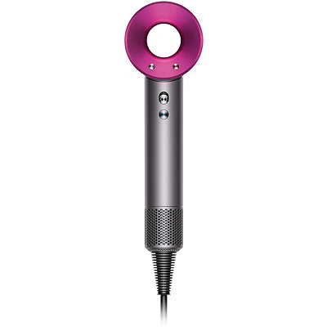
Introduction
Define
Measure
Analyze
Improve
Control
Problem Statement
Add text
G
A
L
Goal Statement
Add text

Slide 7
Project Scope
Define
Measure
Analyze
Improve
Control
In scope
Out scope
Add text
Second level
Third level
Fourth level
Add text
Second level
Third level
Fourth level
Key metrics
Add text

Slide 8
Project Time Plan
Define
Measure
Analyze
Improve
Control
Phase | Deliverables | Duration | Wk 1 - 8 |  |  |  | Wk 9 - 16 |  |  |  | Wk 17 - 24 |  |  |  | Wk 25 - 32 |  |  |  | Wk 36
Define | VOC analysis SIPOC Project charter sign-off Identify CTQs
Measure | Operational definition of CTQs VSM MSA Data collection & analysis Baseline process / design score card
Analyze | Identify potential root causes Root cause validation & effect DOE Implement quick win
Improve | Develop future state VSM Improve action plan Validate optimized process/design
Control | Standardize revised process/design Control plan SPC implementation Project closure
Toll gate review I
Toll gate review II
Final Presentation

Slide 9
Project Time Plan
Define
Measure
Analyze
Design
Verify
Phase | Deliverables | Duration | Wk 1 - 8 |  |  |  | Wk 9 - 16 |  |  |  | Wk 17 - 24 |  |  |  | Wk 25 - 32 |  |  |  | Wk 36
Define | VOC analysis SIPOC Project charter sign-off Identify CTQs
Measure | Operational definition of CTQs QFD – House of Quality MSA Data collection & analysis Baseline process / design score card
Analyze | Functional requirements Concept selection DOE Functional Block Diagram
Design | Develop design of Xs Optimize design Build design
Verify | Test of prototype Design review & score card Process / Design transfer Project closure
Toll gate review I
Toll gate review II
Final Presentation

Slide 10
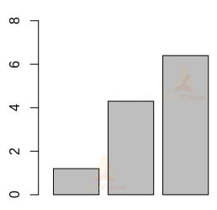
Cost Benefits
Define
Measure
Analyze
Improve
Control
Benefits
Estimated financial benefits
Second level
Third level
Fourth level
Summary calculation
Add chart

Slide 11
Project Risks & Mitigation Action
Define
Measure
Analyze
Improve
Control
Potential risk | Mitigation action
1.
2.
3.
4.
Ground rule

Slide 12
SIPOC – State the process name
Define
Measure
Analyze
Improve
Control
Supplier
Input
Process
Output
Customer
Add text
Add text
Add text
Add text
Add text
Add text
Add text
Add text

Slide 13
Functional Block Diagram
Define
Measure
Analyze
Improve
Control
In Scope
System
Air Flow
Heater
Electronics/Software
Performance & User interaction
Separation
Assembly
Motor Assembly
Flow Splitter Assembly
Heater Assembly
Motor Control System
Heater Control System
Filter Assembly
Sample
Part
V9 Motor
Flow Splitter Rubber
Heater
Thermistor
Outer Filter Cage
Motor Mount
Flow Splitter Connector
Heater Nozzle
Grommet
Inner Filter Cage Overmould
Harness
Heater Frame
Ioniser
V9 Motor EMC Shield
Frame Seals
Rubber Pad
Mica Sheet

Slide 14

Voice of Customer (VOC)
Define
Measure
Analyze
Improve
Control
Who are the customer
In what way their voice is captured
Decide where to focus improvement efforts

Slide 15
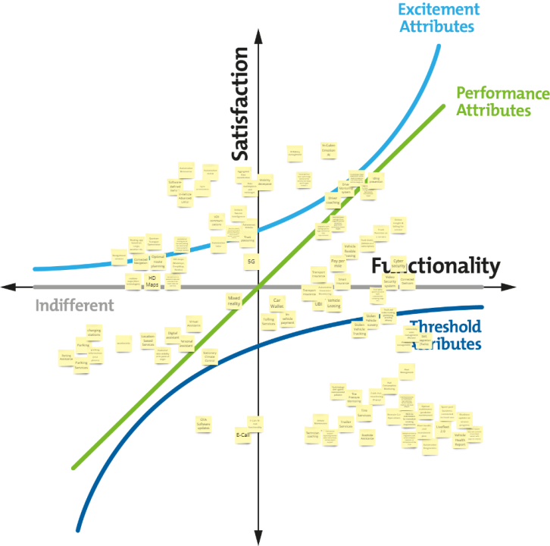
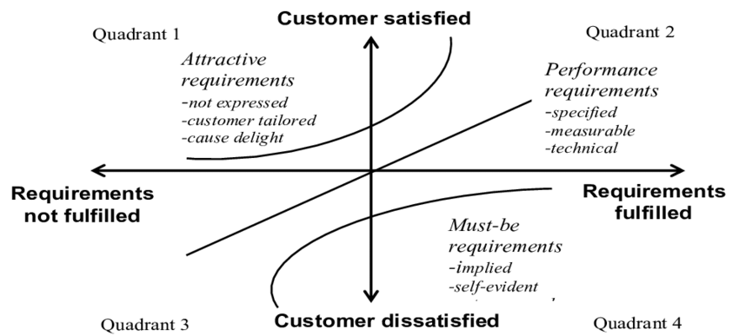
Voice of Customer (VOC) to Critical to Requirements (CTR)
Define
Measure
Analyze
Improve
Control
Kano Model
Ranking scheme which distinguishes between Must-be requirements and differentiating attributes
Sample

Slide 16
Critical to Quality (CTQ)
Define
Measure
Analyze
Improve
Control
Specification statement for Critical to Requirements (CTRs)
It is important to be able to link the project CTQs back to the CTRs of customer
Voice of Customer
Customer requirements
CTQs

Slide 17
Define
Measure
Analyze
Improve
Control
CTQ Operational Definition
Data Collection Plan
Measurement System Analysis / Attribute Agreement Analysis
Current State Value Stream Mapping
Current Performance (Baseline Measurement)
Score Card

Slide 18
Define
Measure
Analyze
Design
Verify
CTQ Operational Definition
Data Collection Plan
Measurement System Analysis / Attribute Agreement Analysis
Current State Value Stream Mapping
Current Performance (Baseline Measurement)
Score Card
CTQs by House of Quality & Operational Definition

Slide 19




CTQ Operational Definition
Define
Measure
Analyze
Improve
Control
Add text (CTQ statement)
Criteria
Test
Decision
Criteria 1
Criteria 2
Yyy
Criteria 3
Xxx

Slide 20

CTQ Tree
Define
Measure
Analyze
Improve
Control
Add text
High level CTQ | 2nd level CTQ / CTP | Spec. / Requirement | Spec. / Requirement
CTQ 1
CTQ 2

Slide 21

Data Collection Plan
Define
Measure
Analyze
Improve
Control
Add text
What | Why | When | How | …
1.
2.
3.
4.

Slide 22







Measurement System Analysis
Define
Measure
Analyze
Improve
Control
Process duration
Add text (Activity / task element)
Add text (Method / equiptment)
Add process flow

Slide 23
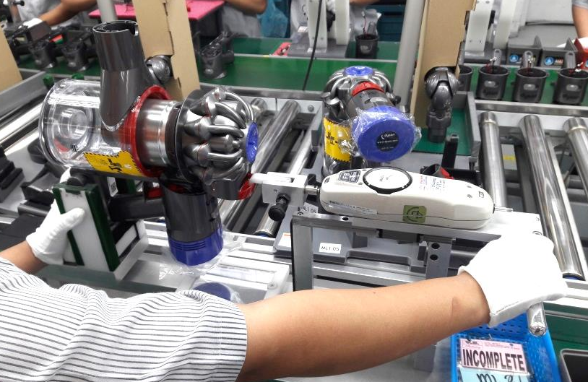

Measurement System Analysis
Define
Measure
Analyze
Improve
Control
Gage R&R test set up
Add text (Tester)
Add text (Test criteria / steps)
Add picture

Slide 24
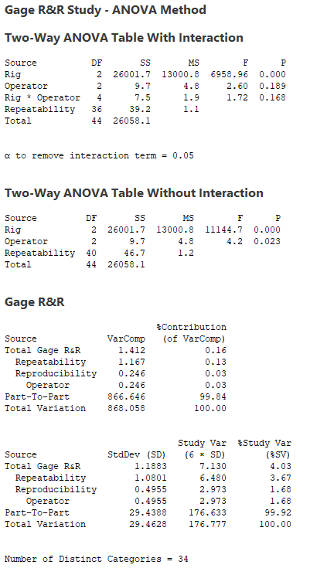
Measurement System Analysis
Define
Measure
Analyze
Improve
Control
Add text (Tester / Measurement process)
Add text (Result summary & conclusion)
PTP variation contributes the most
Add analysis result
%Study Variation of total Gage R&R<10%
All range below UCL
NDC > 5

Slide 25
Measurement System Analysis
Define
Measure
Analyze
Improve
Control
Add text (Additional subject)
Add text

Slide 26
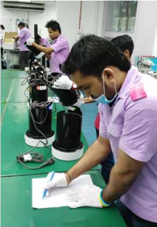

Attribute Agreement Analysis
Define
Measure
Analyze
Improve
Control
Preparation & test
Add text (Sample)
Add text (Inspection criteria / steps)
Add picture

Slide 27
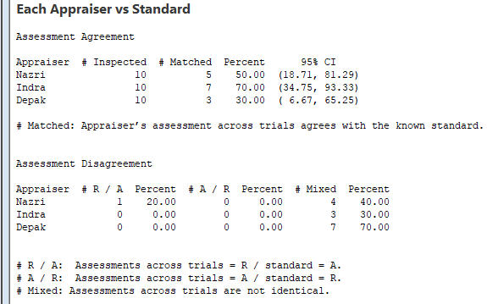
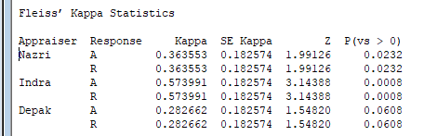
Attribute Agreement Analysis
Define
Measure
Analyze
Improve
Control
Add text (Test method / Measurement process)
How well the appraiser agree with the standard
Add text (Result summary & conclusion)
How well the appraiser agree with themselves
Add analysis result

Slide 28
Attribute Agreement Analysis
Define
Measure
Analyze
Improve
Control
Add text (Additional subject)
Add text

Slide 29

Current state Value Stream Mapping (Operational)
Define
Measure
Analyze
Improve
Control
Add text (Process)
Add text (Result summary)
Quarter forecast
Quarter forecast
Production control
Daily schedule
Customer
Supplier
650 / day
I
Weekly
Monthly schedule
Weekly schedule
Daily delivery plan
4200 / week
Daily schedule
I
OP2
Add current state VSM
OP1
OP3
OP4(1)
OP5
OP6
OP7
OP8
Facing drilling
Facing Turning
Finishing
Threading
Grinding
Washing
Measuring
Balancing
I
CT:33.1
DT: -
FTY: -
CT:46.6
DT: -
FTY: -
CT:35
DT:11.6
FTY: -
I
CT:56
DT:12
FTY: -
CT:49.5
DT:32
FTY:95%
CT:41.1
DT:40.4
FTY: -
CT:23
DT:55.5
FTY: 99.5%
CT:38.6
DT:42.9
FTY: 99%
80 pcs /
load
70 pcs / Hr
Quality issue
Inventory waste
OP4(2)
Threading
Cycle time = 342.9
Lead time = 546.3
CT ratio = 62.8%
Takt time
= 47.1
CT:76
DT:18
FTY: -
Long CT
33.1
0
46.6
11.6
35
18
76
32
49.5
40.4
41.1
55.5
23
42.9
38.6

Slide 30
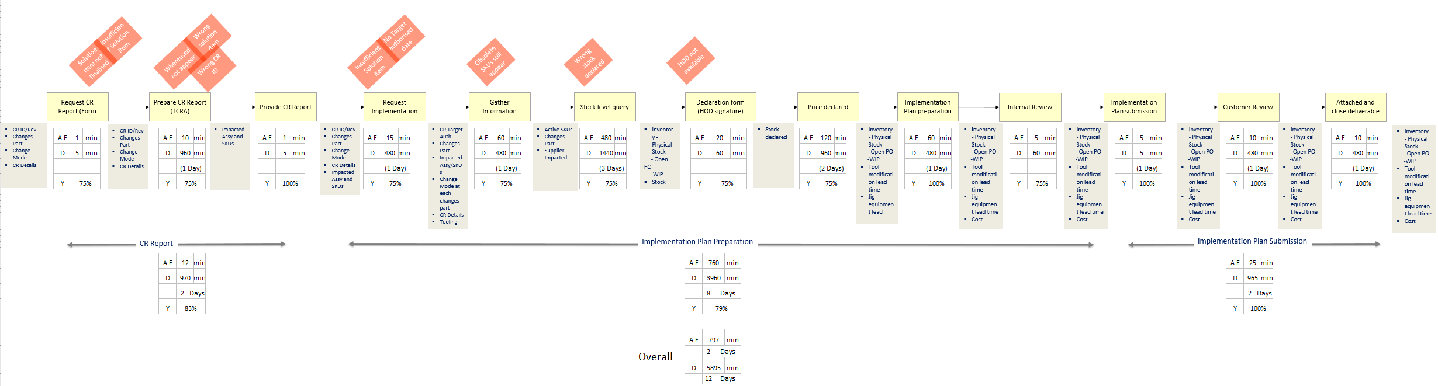
Current state Value Stream Mapping (Transactional)
Define
Measure
Analyze
Improve
Control
Add text (Process)
Stream 1
Stream 2
Add current state VSM
Bottle neck
Add text (Result summary & conclusion)

Slide 31
Current state Value Stream Mapping
Define
Measure
Analyze
Improve
Control
Add text (Process Detail)
Add text

Slide 32
Current Performance (Baseline measurement)
Define
Measure
Analyze
Improve
Control
Add text (CTQ measurement by Yield)
Add text (Result summary)
Add performance plot

Slide 33
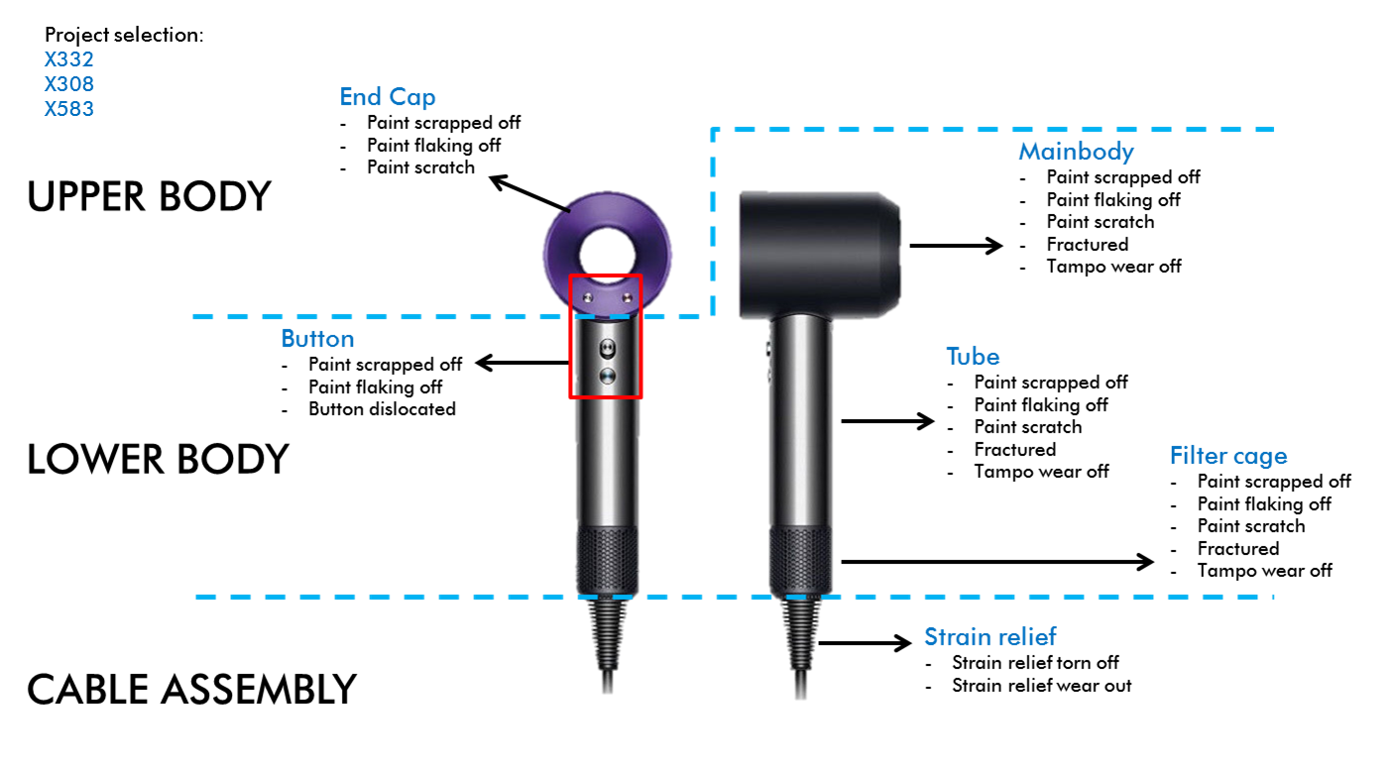

Current Performance (Baseline measurement)
Define
Measure
Analyze
Improve
Control
Add text (CTQ measurement by DPMO)
Add text (Result summary)
Attribute | Statistic
Sample size | 300
Defective unit | 65
CTQs (Defective opportunities) | 23
DPMO | 9420
Process Sigma level | 3.85
Add picture

Slide 34
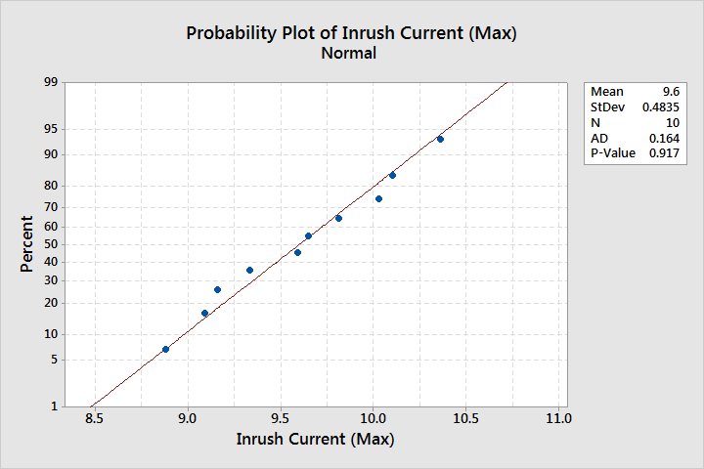
Current Performance (Baseline measurement)
Define
Measure
Analyze
Improve
Control
Add text (CTQ measurement by capability)
Add text (Result summary)
Add performance plot

Slide 35
Current Performance (Baseline measurement)
Define
Measure
Analyze
Improve
Control
Add text (CTQ measurement, another metric)
Add text (Result summary)

Slide 36
(Design / Process) Score Card
Define
Measure
Analyze
Improve
Control
Add text (CTQ)
Current
Desired
CTQ | Xxx | Yyy | Zzzz |  | Xxx | Yyy | Zzz
CTQ 1
CTQ 2
Add desired performance

Slide 37
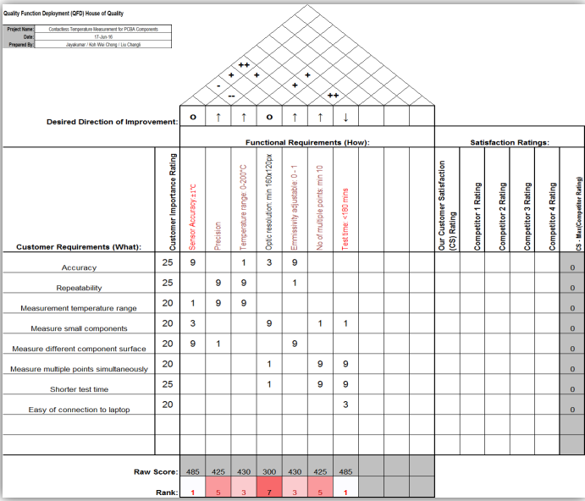
Critical To Quality by House of Quality
Define
Measure
Analyze
Design
Verify
Add text (High level functional requirements – How)
Add text (Design characteristic importance)
Add text (Contradiction requirements)
Add House of Quality

Slide 38
CTQs Operational Definition
Define
Measure
Analyze
Design
Verify
Add text
High level CTQ | 2nd level CTQ / CTP | Criteria | Test | Decision
CTQ 1
CTQ 2

Slide 39
Define
Measure
Analyze
Improve
Control
Define Potential Root Causes (Xs)
Root Cause Validation Plan
Validate Root Cause (Xs) & Effect
Identify Quick Wins

Slide 40
Define
Measure
Analyze
Design
Verify
Functional Requirements (CTQs) High Level Design Concept
Concept Selection
Risk Assessment & Design Review
Functional Block Diagram

Slide 41






Potential Root Causes (Xs)
Define
Measure
Analyze
Improve
Control
Add text (Design system)
Add text
Motor Assembly
Software
V9 Motor
Motor Control
Flow Splitter Assembly
Heater Control
Flow Splitter Connector
Motor Mount
Add Fishbone diagram
Flow Splitter Rubber
To reduce Peak Air Exit temperature
Open Wire Heater
Coil
Air Exit Gap
Heater Nozzle
Heater Frame
Pillar
Air Exit Length
Ramp Angle
Heater Assembly

Slide 42
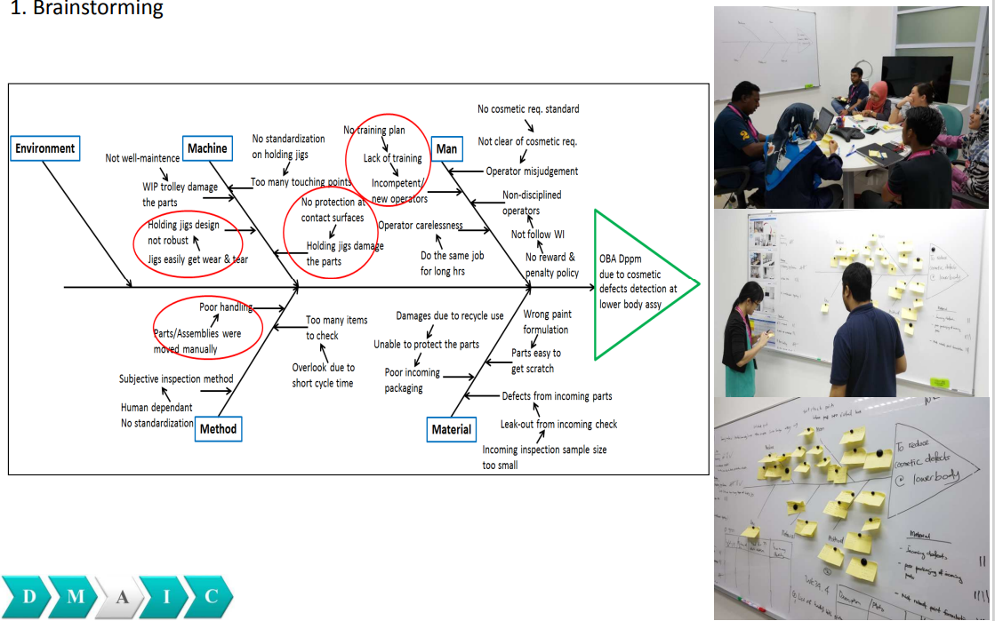
Potential Root Causes (Xs)
Define
Measure
Analyze
Improve
Control
Add text (5M + 1E)
Method
Lack of robust Poka Yoke feature on assembly jig (Block gage)
Add text
Measurement
Incorrect assembly between tension bar and leaf spring
Tension plate force measurement error (Result fluctuation)
Lack of operator training due to time & resource constraint (Covid safety measures - Border closure)
Man
1. Preload force fail at lower/upper limit at tip/heel measurement
2. Plate travel fail at lower/upper limit at tip/heel measurement
3. Bottom out force fail at lower/upper limit at tip/heel measurement
Add Fishbone diagram
Vibration translation from mainline conveyor
Part interaction
- Tension Bar
Part interaction
- Heater Frame
Poor UUT fitting to Tension plate force tester holding jig
Environment
Part interaction
- Tip retainer
Part interaction
- Arm
Part interaction
- Heater Nozzle
Part interaction
- Leaf Spring
Machine
Materials

Slide 43
Root Cause Validation Plan
Define
Measure
Analyze
Improve
Control
Add text (Problem statement)
Add text
No | Potential root cause | Analysis tool | Effect | Note / Action
1. | Seal distorted | 5 Why Graphical analysis |  | Box-plot
2. | Accidentally tweak seal | 5 Why Process analysis |  | Test rig improvement
3. | Improper training | 5 Why |  | Quick win
4. | Uncertainty study on golden sample | Statistical analysis |  | Gage R&R
5. | Seal configuration | Statistical analysis |  | Hypothesis test
…

Slide 44
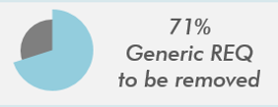
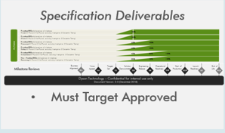
Validate Root Cause (Xs)
Define
Measure
Analyze
Improve
Control
Add text (5 Why)
Add text (What is the root cause(s), and how did you know
Why/Symptom
Why?
Why?
No appropriate Test Method for generic REQ
Compulsory to link TM by system even though unnecessary
Need to store information
…
Generic REQ created doesn’t need TM
Why?
No specific holder, RED is the only suitable item
Validation
Ensure REQ acquire Target Approved status
It is part of specification deliverables
Sample

Slide 45
Validate Root Cause (Xs)
Define
Measure
Analyze
Improve
Control
Add text (Process analysis)
Add text (What is the root cause(s), and how did you know
No | Operation / Task | Lead time (day) | Standard (day) | NVA (Day) | 7 + 1 Waste / Plan
1. | Check requirement specification availability | 1 | 0.5 | 0.5 | Motion & Skill Document available in Teamcenter Training, guide update
2. | Motor life test (DTM081) | 6 | 5 | 1 | Transportation Trigger & suspend unit completed 500 hours test
3. | Sample machine & cleaner head order | 2 | 0.5 | 1.5 | Wait Quotation in advanced
4. | Thermocouple installation & MLT setup | 2 | 1 | 1 | Inventory Prearrangement with technician & MLT
5. | …
Sample

Slide 46
Validate Root Cause (Xs)
Define
Measure
Analyze
Improve
Control
Add text (Graphical analysis)
Add text (What is the root cause(s), and how did you know
Sample

Slide 47
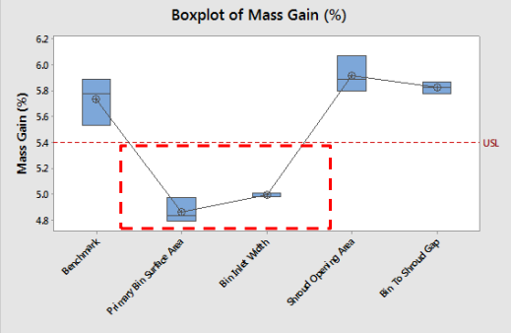
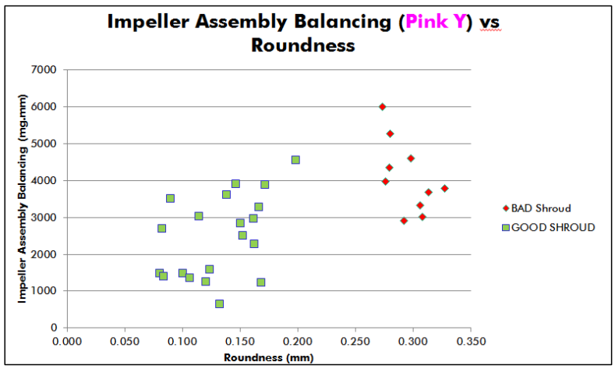
Validate Root Cause (Xs)
Define
Measure
Analyze
Improve
Control
Add text (Graphical analysis)
Add text (What is the root cause(s), and how did you know
Sample

Slide 48
Validate Root Cause (Xs)
Define
Measure
Analyze
Improve
Control
Add text (Process analysis)
Add text (What is the root cause(s), and how did you know
Operation type
Operation type
Action change
No | Operation | Value added | Incidental waste | Pure waste | Time (hr) | Purpose? | Where should be done? | When should be done? | Who should be done? | How should be done? | Note / Plan
1. | Request CR report | Y |  |  | 5 | Communicate brief of changes | Registry task request | Implementation plan identified | CR owner | Teamcenter Solution item ready | Training Brief / Guide update
2. | Request implementation plan | Y |  |  | 16 | Define timeline CR implement into production | Email com. | Before CR authorise | CR owner Ops team | Email com. | Training Brief / Guide update
3. | HOD signature |  |  | Y | 1 | Approval on stock & cost declared to customer | CM | Received stock level & price | CM | Email com. | Optional
4. | Request stock level | Y |  |  | 24 | Est. CM current stock level | Email com. | Received CR report | CM | Email com. | CM brief
5. | Close CR deliverables |  |  | Y | 8 | For CR reviewer cost incurred | Teamcenter | Completed review | Ops team | Teamcenter | Combine deliverables
Sample

Slide 49
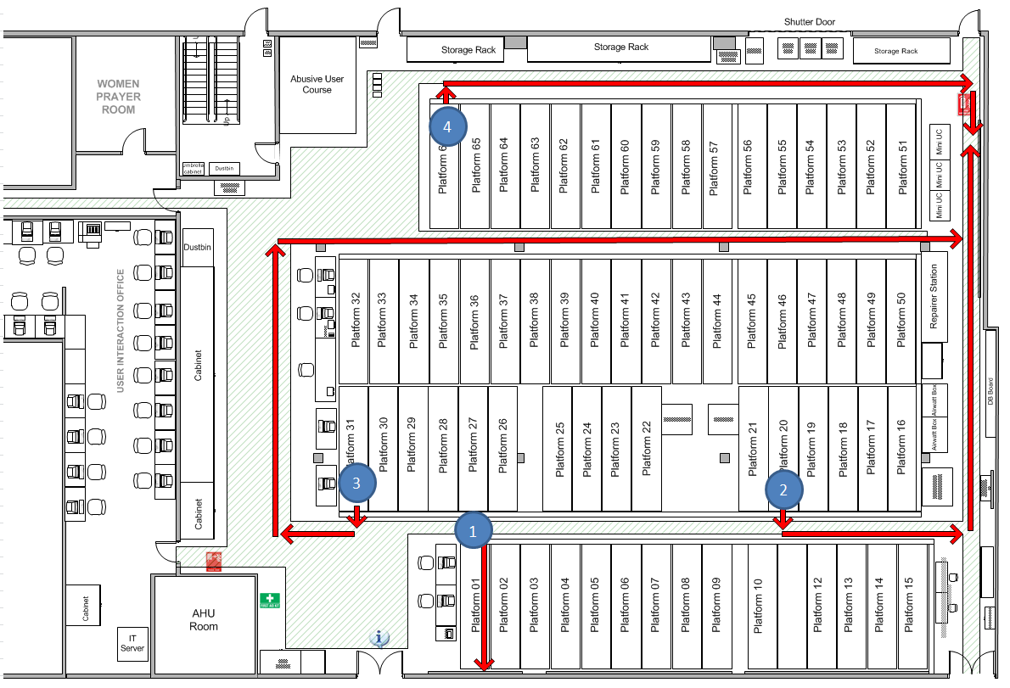
Validate Root Cause (Xs)
Define
Measure
Analyze
Improve
Control
Add text (Spaghetti diagram)
Add text (What is the root cause(s), and how did you know
Sample
Step | Distance (M) | Time | Freq. | Total distance | Total duration
1 to 2 | 10 | 24” | 2 | 20 | 48”
2 to 3 | 70 | 168” | 1 | 70 | 168”
3 to 4 | 70 | 168” | 3 | 210 | 504”
4 to 1 | 90 | 216” | 5 | 450 | 1080”

Slide 50
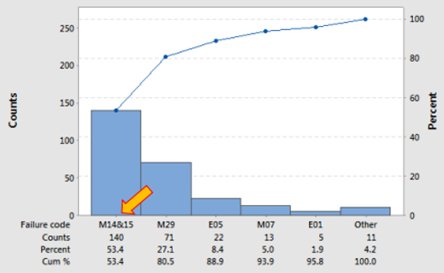
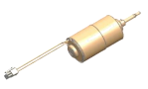
Validate Root Cause (Xs)
Define
Measure
Analyze
Improve
Control
Add text (Failure analysis)
Add text (What is the root cause(s), and how did you know
Why?
Why?
Coil winding melted Open coil circuit
Electrical
Why?
Soldering control
Pareto
Others
Mechanical
Bearing failure Impeller broken Magnet burst
Salt mist clean control
Sample

Slide 51
Validate Root Cause (Xs)
Define
Measure
Analyze
Improve
Control
Add text (Failure analysis)
Add text (What is the root cause(s), and how did you know

Slide 52
Validate Root Cause (Xs)
Define
Measure
Analyze
Improve
Control
Add text (Paired comparison)
Add text (Sample size, BOB & WOW)
Add text (Steps / Quality parameter)

Slide 53
Validate Root Cause (Xs)
Define
Measure
Analyze
Improve
Control
Add text (Paired comparison)
Add text (What is the root cause(s), and how did you know)
Rank | Brush worn | Insulation degraded | Corrode | Lubricant | Critical dim. 1 | Critical dim. 2 |  | Rank | Brush worn | Insulation degraded | Corrode | Lubricant | Critical dim. 1 | Critical dim. 2
1 | L | L | L | L | L | L |  | 11 | H | H | L | H | H | H
2 | L | L | L | L | L | L |  | 12 | H | L | L | H | L | H
3 | L | L | H | L | L | H |  | 13 | L | H | H | H | H | H
4 | L | H | H | L | L | L |  | 14 | H | H | L | H | L | L
5 | L | H | L | L | L | H |  | 15 | L | L | L | L | H | L
6 | H | L | L | L | L | L |  | 16 | H | L | H | H | H | H
7 | L | L | H | H | H | H |  | 17 | H | H | L | H | H | H
8 | L | L | H | L | L | L |  | 18 | H | H | H | H | H | L
9 | H | H | L | L | H | L |  | 19 | H | H | H | H | H | H
10 | L | L | H | L | L | L |  | 20 | H | H | H | H | H | H
 |  |  |  |  |  | Total End Count |  |  | 5+5=10 | 3+4=7 | 2+3=5 | 6+5=11 | 6+6=12 | 2+2=4
 |  |  |  |  |  | Confidence |  |  | 99% | 95% | NA | 99% | 99% | NA
Sample

Slide 54
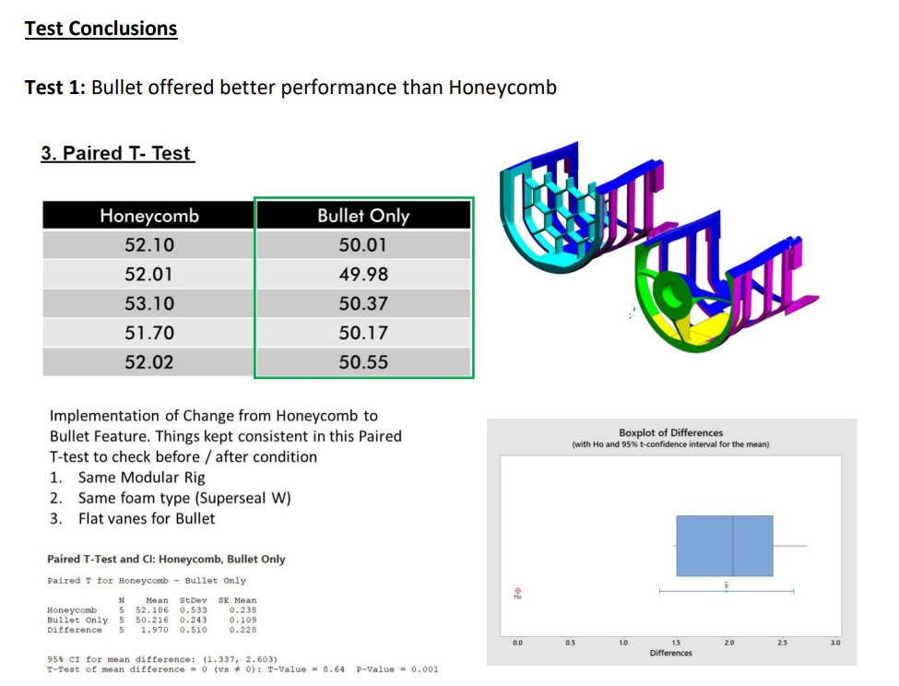
Validate Root Cause (Xs)
Define
Measure
Analyze
Improve
Control
Add text (Paired T-test)
Add text (What is the root cause(s), and how did you know)
Sample

Slide 55
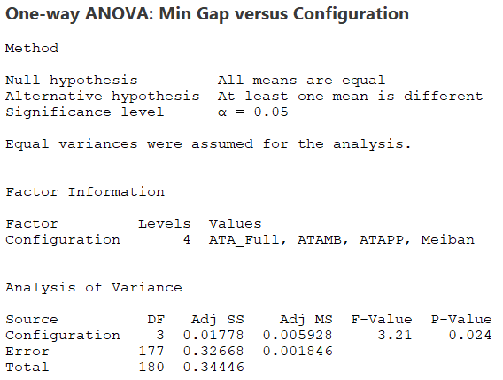
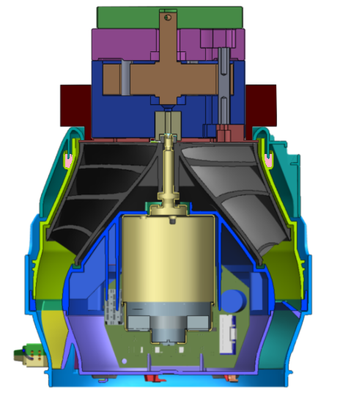
Validate Root Cause (Xs)
Define
Measure
Analyze
Improve
Control
Add text (Oneway ANOVA)
Add text (What is the root cause(s), and how did you know)
Sample

Slide 56
Validate Root Cause (Xs)
Define
Measure
Analyze
Improve
Control
Add text (Another method)
Add text (What is the root cause(s), and how did you know)

Slide 57
Root Cause (Xs) & Effects
Define
Measure
Analyze
Improve
Control
Add text (What are the Xs & effects)
Add text
No | Root cause | Analysis tool | Effect | Note / Action
1. | Seal distorted | 5 Why Graphical analysis | High | Box-plot
2. | Accidentally tweak seal | 5 Why Process analysis | Medium | Test rig improvement
3. | Improper training | 5 Why | Low | Quick win
4. | Uncertainty study on golden sample | Statistical analysis | High | Gage R&R
5. | Seal configuration | Statistical analysis | Medium | Hypothesis test
…

Slide 58
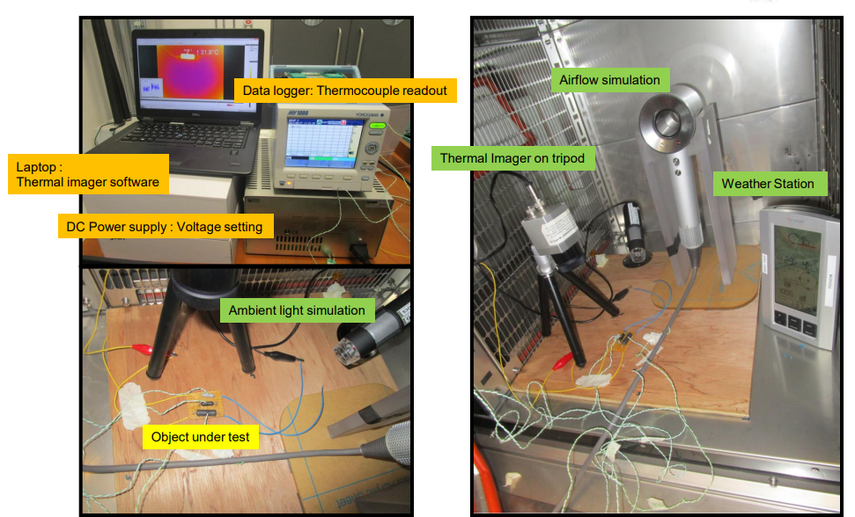
Validate Root Cause (Xs)
Define
Measure
Analyze
Improve
Control
Add text (Product / Process)
Add text (DOE – 2k series Fractional Factorial Design)
No | Potential factor (X) | Data type | Low | High | Unit
1. | Emissivity | Variable | 0.8 | 1.0
2. | Distance (Sensor to object) | Variable | 10 | 30 | cm
3. | Airflow | Attribute | With | Without
4. | Ambient light | Attribute | With | Without
5. | Surface color (Object) | Attribute | Black | Grey
6. | FOV_lense | Attribute | 38 | 62 | Degree(°)
Covariate
Xxx
Yyy
Block
Zzz
Sample
Test set-up

Slide 59
Validate Root Cause (Xs)
Define
Measure
Analyze
Improve
Control
Add text (DOE Detail)
Add text

Slide 60
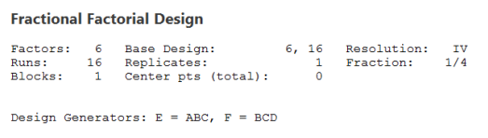
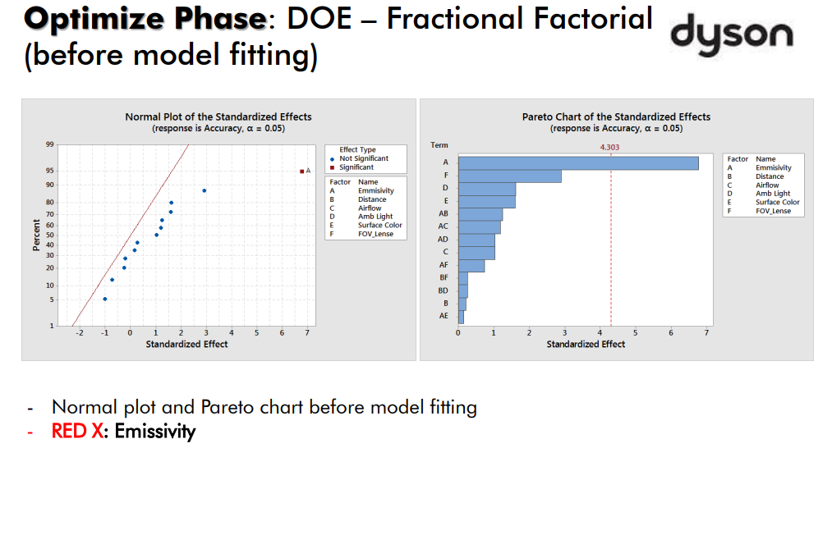
Root Cause (Xs) & Effects
Define
Measure
Analyze
Improve
Control
Add text (What are the Xs & effects)
Add text (Conclusion)
Sample

Slide 61
Root Cause (Xs) & Effects
Define
Measure
Analyze
Improve
Control
Add text (Detail)
Add text

Slide 62
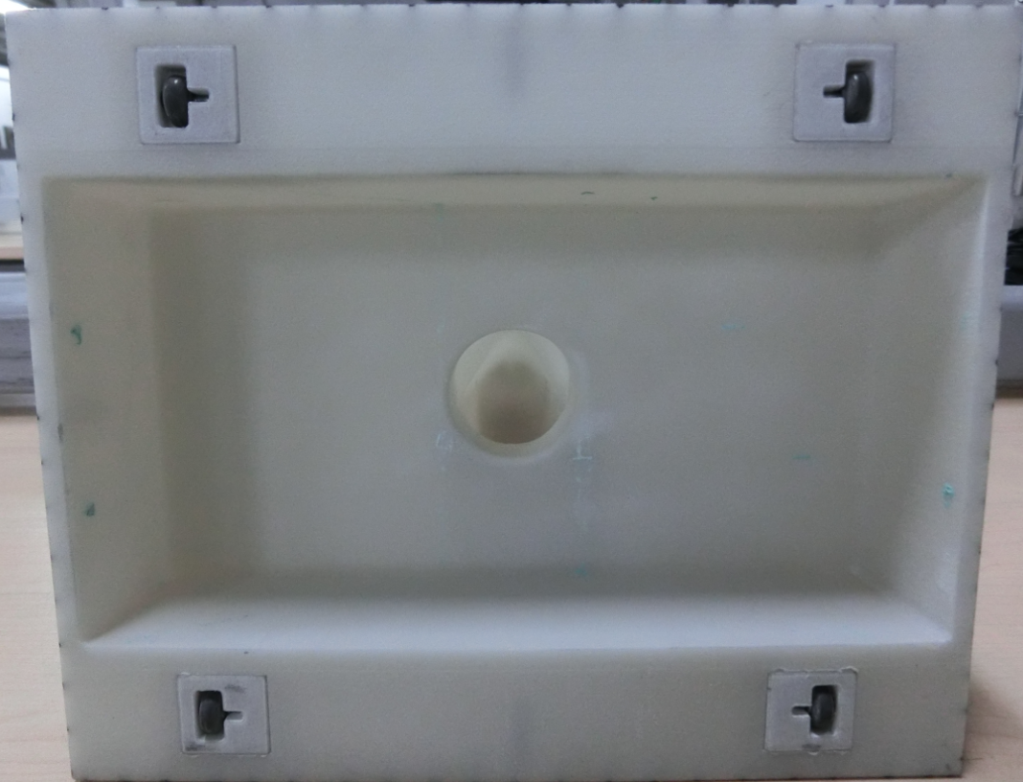
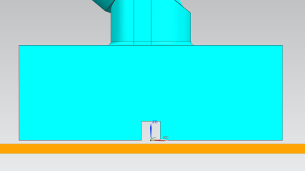
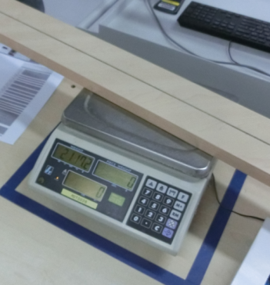
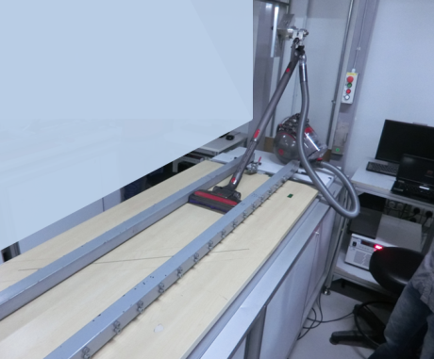
Validate Root Cause (Xs)
Define
Measure
Analyze
Improve
Control
Add text (Product / Process)
Add text (Shainin DOE)
ID | Potential factor (X) | Data type | Low (-ve) | High (+ve) | Design
A | Suction aperture | Variable | 85 | 135
B | Inner wall angle | Variable | 60 | 90
C | Side bleed height | Variable | 10 | 2
D | Side bleed length | Variable | 10 | 2
E | Side bleed depth | Variable | 1 | 2
Sample
60deg
90deg
Test set-up

Slide 63
Validate Root Cause (Xs)
Define
Measure
Analyze
Improve
Control
Add text (DOE Detail)
Add text

Slide 64
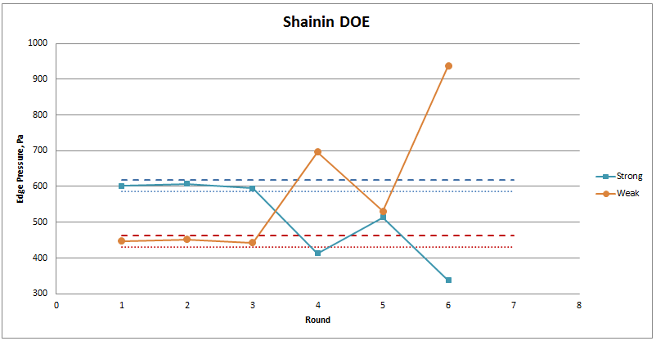
Root Cause (Xs) & Effects
Define
Measure
Analyze
Improve
Control
Add text (What are the Xs & effects)
Add text (Conclusion)
Shainin DOE – Variable search
Stage 1 – Initial runs
Stage 2 - Elimination
Stage 3 – Capping run
All three high levels (+ve) are better than all low level (-ve)
D : d > 1.25 : 1
D=µhigh-µlow
d=Rhigh-Rlow
AB – Interaction effect
A – Important
B – Important
Sample
Stage 1
Stage 2
Stage 3
A
B
AB

Slide 65
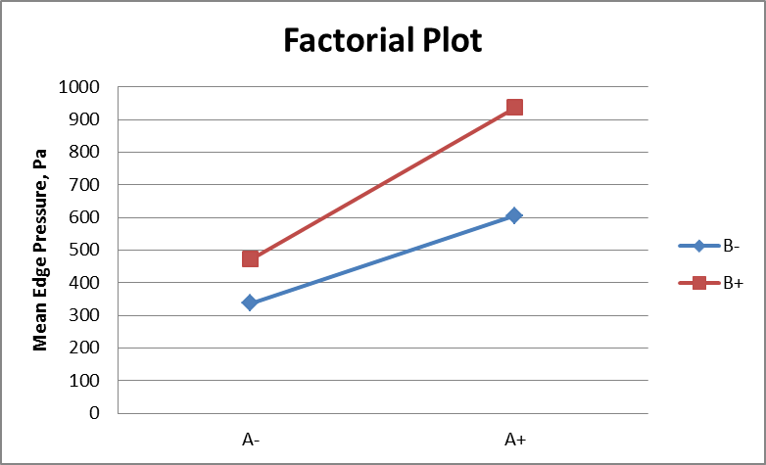
Root Cause (Xs) & Effects
Define
Measure
Analyze
Improve
Control
Add text (What are the Xs & effects)
Add text (Conclusion)
Stage 1 – Initial runs
Stage 2 - Elimination
Stage 3 – Capping run
All three high levels (+ve) are better than all low level (-ve)
D : d > 1.25 : 1
D=µhigh-µlow
d=Rhigh-Rlow
AB – Interaction effect
A – Important
B – Important
Stage 4 – Factorial analysis
A – Red “X” B – Pink “X” AB interaction is weak
Sample

Slide 66
Root Cause (Xs) & Effects
Define
Measure
Analyze
Improve
Control
Add text (Detail)
Add text

Slide 67
Identify Quick Wins
Define
Measure
Analyze
Improve
Control
Add text (Validated root causes)
Add text
No | Quick win | Activities | Target completion date | Actual completion date | Standard of completion
1. | 5S storage warehouse | Optimize storage space | DDMMYY | DDMMYY | Distinguished fast-moving, slow-moving item
2. | Assembly jig & fixtures | Eliminate assembled unit expose to collide | DDMMYY | DDMMYY | Visual defective <2%
3. | Operator skill | Revise WI Proper training | DDMMYY | DDMMYY | Quick win
4. | Gage R&R | Review SOP Proper training | DDMMYY | DDMMYY | Total % Study Var. of total Gage R&R <20% NDC > 5 R-Chart by operator – All data point below UCL
…
Sample

Slide 68
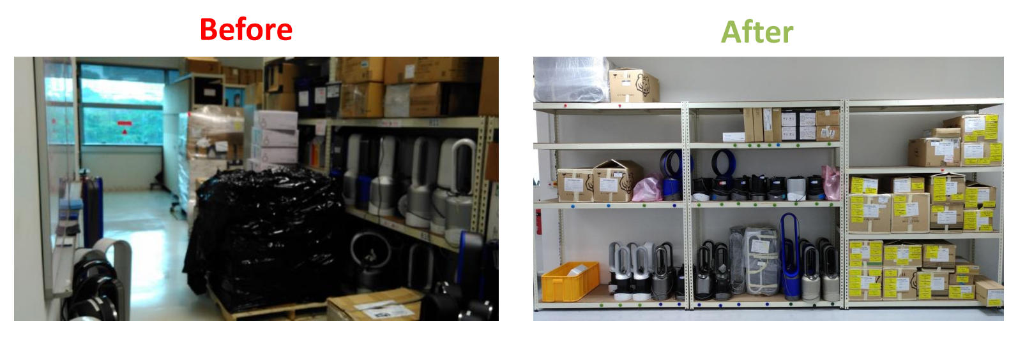
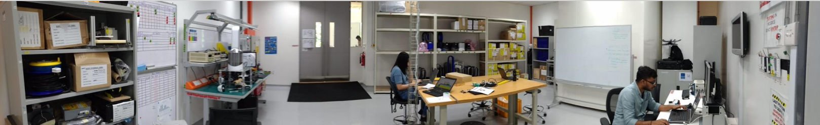
Identify Quick Wins
Define
Measure
Analyze
Improve
Control
Add text (5S storage warehouse)
Add text (Detail)
Sample

Slide 69
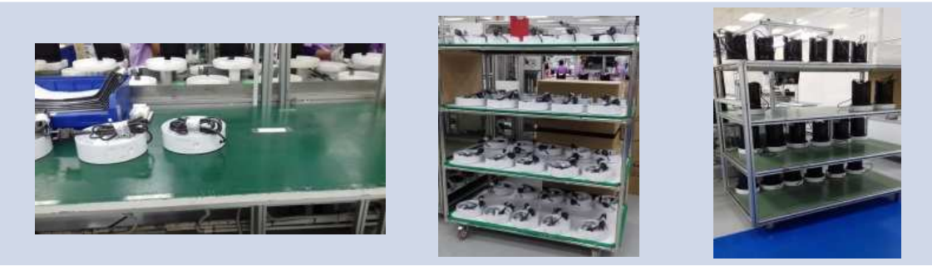
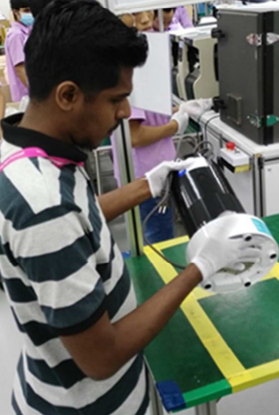
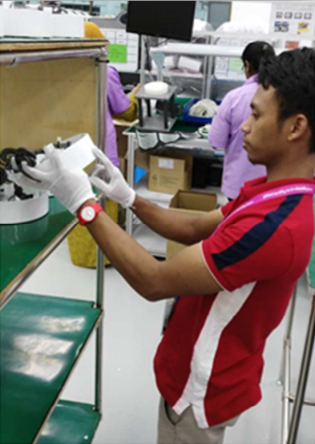
Identify Quick Wins
Define
Measure
Analyze
Improve
Control
Add text (Assembly jig & fixtures, operator skill)
Add text (Detail)
Sample

Slide 70
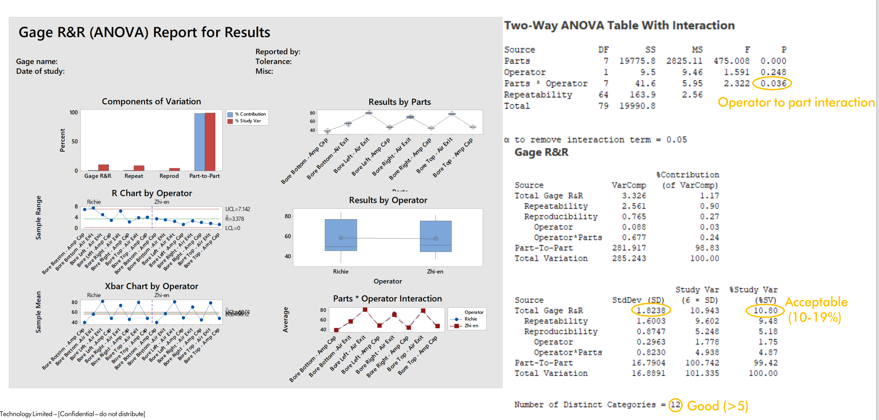
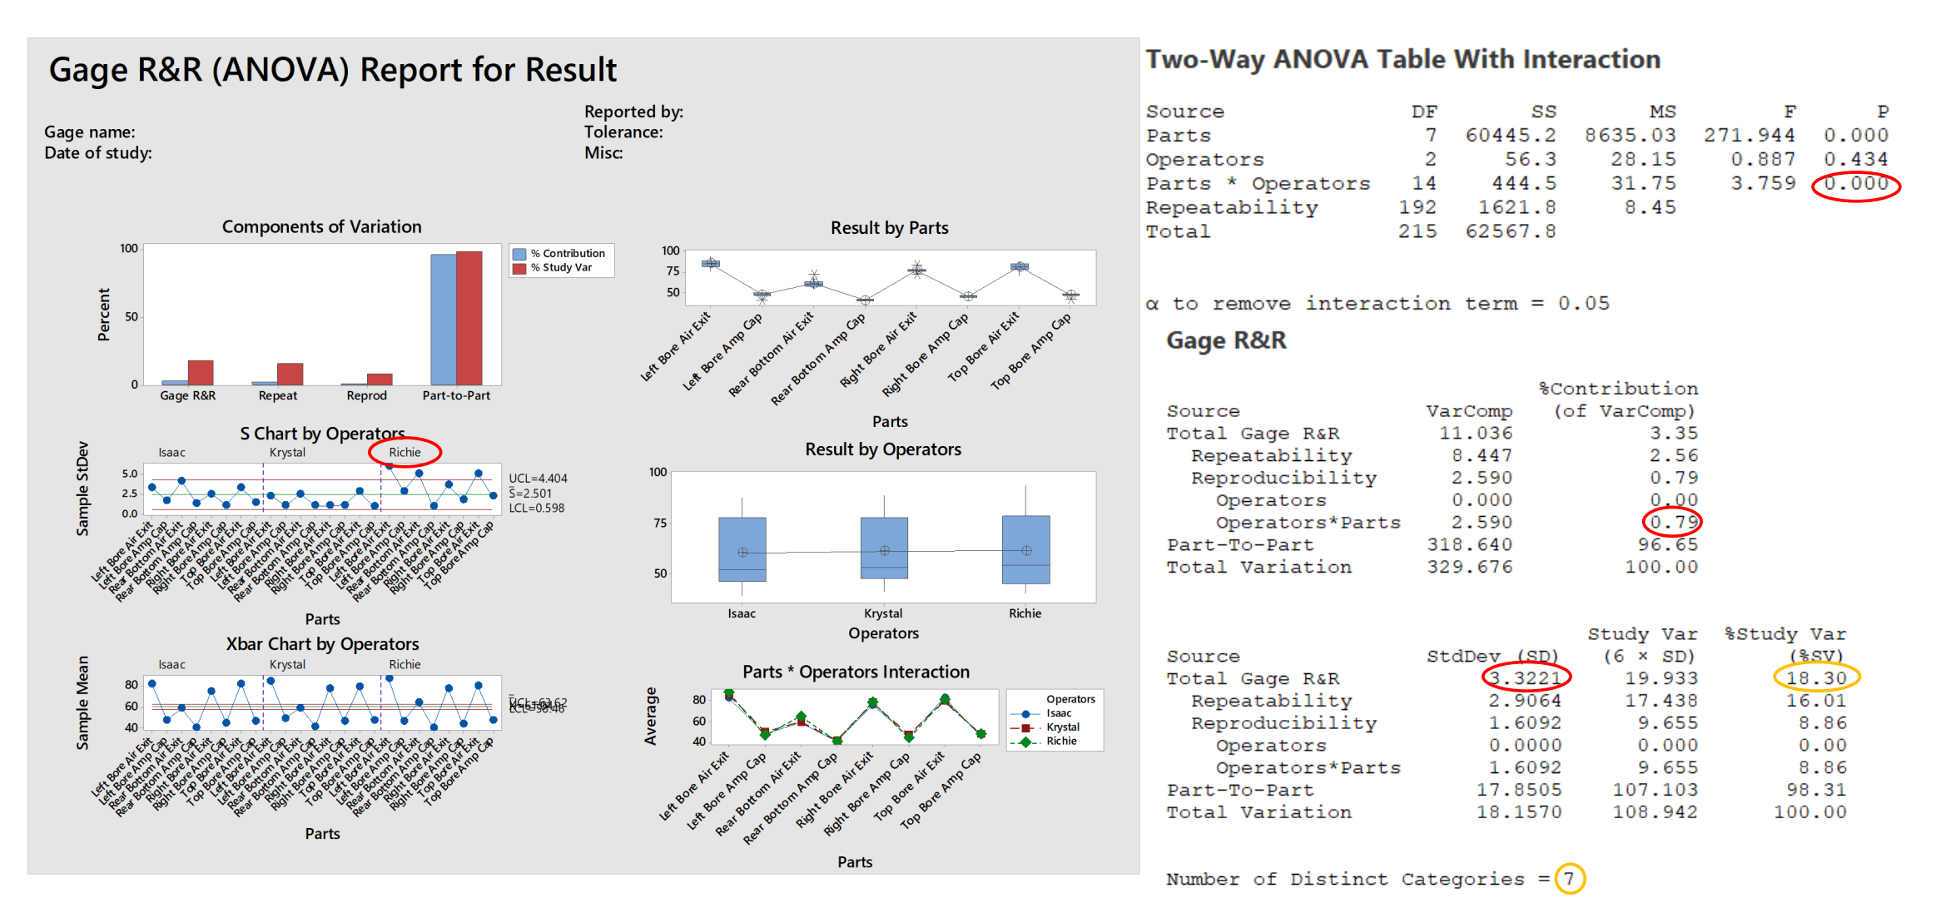
Identify Quick Wins
Define
Measure
Analyze
Improve
Control
Add text (Gage R&R)
Add text (Detail)
Sample

Slide 71
High Level Design Concept – Product / Process name
Define
Measure
Analyze
Design
Verify
Add text (Translation of functional requirements)
Add text (Detail)
Contactless temperature measurement system
Sensoring system
Sensor fixture
Object platform
Detector
Lens / Window
PCBA mounting pltform
Sensor mounting base
Outputs
USB 2.0
Sensor axis adjustment
Platform X-Y axis adjustment
Extension cable to PC
Graphic user interface

Slide 72
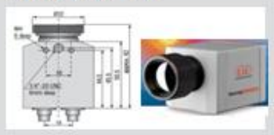
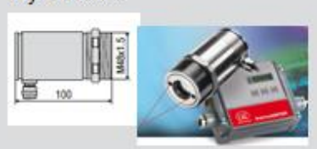
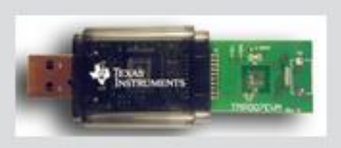
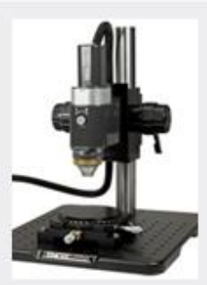
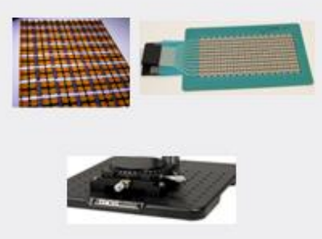
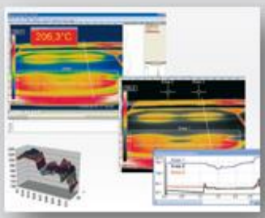
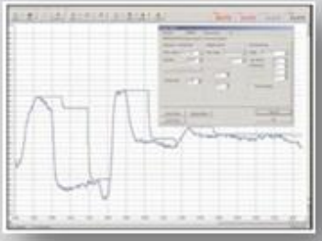
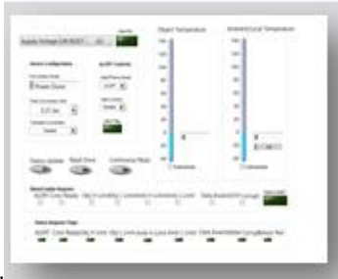
High Level Design Concept – Product / Process name
Define
Measure
Analyze
Design
Verify
Add text (Morphological Box)
Add text (Detail)
Functional requirement | Alternative 1 | Alternative 2 | Alternative 3
Sensoring system | FPA µbolometer | Pyrometer | Thermopile
Sensor fixture Object platform
Outputs
Concept | A | B | C
Sample 1

Slide 73
High Level Design Concept – Product / Process name
Define
Measure
Analyze
Design
Verify
Add text (Morphological Box)
Add text (Detail)
Functional requirement | Alternative 1 | Alternative 2 | Alternative 3
Controller | Power meter | Multi-meter | Light sensor
Driver | Servo motor | Pneumatic | Stepper motor
Measurement system | Arduino | Manual
Movement mechanism | Separate movement | X & Y movement
Data collection | LCD display | Computer Aided | Visual LED indicator
Concept | A | B | C
Sample 2

Slide 74
Design Concept Selection – Product / Process name
Define
Measure
Analyze
Design
Verify
Add text (Pugh Matrix)
Add text (Detail)
Key criteria | Concept A | Concept B | Concept C | Datum
Sensor - Accuracy | 0 | 0 | 0 | 0
Sensor - Repeatability | + | + | - | 0
Sensor – Temperature range | 0 | 0 | 0 | 0
Sensor – Measure small components | 0 | 0 | 0 | 0
Sensor – Measure multiple points | + | - | 0 | 0
GUI – User friendly | + | + | 0 | 0
GUI – Flexibility (Post processing) | + | + | 0 | 0
Fixture – Design complexity | + | 0 | 0 | 0
Fixture – Flexibility (PCBA support jig) | 0 | 0 | 0 | 0
Test time | + | + | + | 0
Cost | - | - | - | 0
Number of same | 4 | 5 | 7
Number of “+” | +6 | +4 | +2
Number of “-” | -1 | -2 | -2
Design score | 5 | 2 | 0

Slide 75
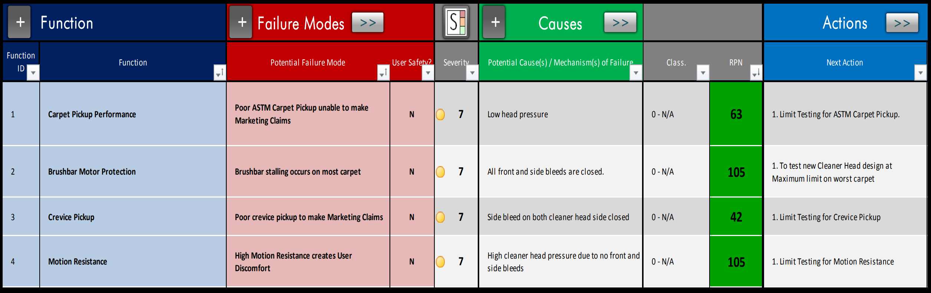
Risk Assessment & Design Review – Product / Process name
Define
Measure
Analyze
Design
Verify
Add text (DFMEA)
Add text (Detail)
Sample

Slide 76

Functional Block Diagram – Product / Process name
Define
Measure
Analyze
Design
Verify
Add text (Selected design concept)
Add text (Detail)
Sample

Slide 77
Design Score Card
Define
Measure
Analyze
Design
Verify
Add text (CTQs)
HOQ (Voice of Customer)
CTQ | Target nominal | LSL | USL | Cpk | Sigma level
CTQ 1
CTQ 2

Slide 78
Define
Measure
Analyze
Improve
Control
Identify Improvement Opportunities
Selected Solution & Action Plan
DOE on Xs / Improve the Xs to Optimize CTQ
Risk Assessment on Xs
Validation & Score Card
Implementation Plan

Slide 79
Define
Measure
Analyze
Design
Verify
Develop Design of Xs
DOE on Xs / Improve the Xs to Optimize CTQ
Risk Assessment on Xs / Design Review
Build Design
Pilot Plan

Slide 80
Improvement Opportunities
Define
Measure
Analyze
Improve
Control
Add text (Solution rational matrix)
Add text (Problem statement )
Low reporting yield on Non-physical Requirement (<70%)
Root causes
State solution theme
State solution theme
System is designed for testing type requirement
No guideline
Requirement classification
- Right definition, right folder, establish database
Remove REQ redundancy
State solution theme
Establish definition based on AS-IS practices
Simplify completion process
Establish guideline of impact
No emphasize the impact
Definition and process of REQ not well defined
No establish control creation process
5S
Sample

Slide 81
Improvement Opportunities
Define
Measure
Analyze
Improve
Control
Add text (Alternate solution, TRIZ inventive solution, Lean principle quick win)
Add text (Detail)

Slide 82

Improvement Opportunities
Define
Measure
Analyze
Improve
Control
Add text (Future state Value Stream Mapping)
Add text (Detail)
Sample
Cycle time = 4.2
Lead time = 16.6
CT ratio = 25%
Cycle time = 3.6
Lead time = 19.1
CT ratio = 19%

Slide 83
Selected Solution & Action Plan
Define
Measure
Analyze
Improve
Control
Add text (Impact & Effort matrix / Payoff matrix)
Add text (Solution selection / prioritize solution)
Establish definition based on AS-IS practices
Requirement classification
Establish guideline of impact
Sample
Remove REQ redundancy
Simplify completion process
Benefit or Impact
5S
Cost or Effort

Slide 84
Selected Solution & Action Plan
Define
Measure
Analyze
Improve
Control
Add text (Pugh Matrix)
Add text (Solution selection)
Concept / Alternate solution
Key criteria | Camera with facial recog. | Digital scrap book | Photo scanner app | Live feed party projector
Am I personally interested | 0 | + | + | +
Does the idea have competitive advantage | - | + | 0 | 0
Is there a clear need | 0 | + | + | -
Are there good market opportunities | 0 | - | + | +
How big is the impact of idea | 0 | + | + | 0
Can I communicate it clearly | 0 | + | + | 0
Number of same | 5 | 0 | 1 | 3
Number of “+” | +0 | +5 | +5 | +2
Number of “-” | -1 | -1 | 0 | -1
Design score | -1 | 4 | 5 | 1
Sample

Slide 85
Selected Solution & Action Plan
Define
Measure
Analyze
Improve
Control
Add text (Selected solution)
Add text (Detail)

Slide 86
Selected Solution & Action Plan
Define
Measure
Analyze
Improve
Control
Add text (Action plan)
Add text (Solution selection)
Wk xx
Wk xx
Wk xx
Wk xx
Wk xx
Wk xx
Wk xx
5S
State action list
State action list
…
…
Solution theme
Requirement classification
Remove REQ redundancy
State action list
…
…
Sample 1
Solution theme
Simplify completion process
Establish definition based on AS-IS practices
State action list
…
…
Solution theme
Establish guideline of impact

Slide 87

Selected Solution & Action Plan
Define
Measure
Analyze
Improve
Control
Add text (Action plan)
Add text (Solution selection)
Sample 2

Slide 88
Selected Solution & Action Plan
Define
Measure
Analyze
Improve
Control
Add text (Detail)
Add text

Slide 89
Improve the Xs to Optimize CTQ
Define
Measure
Analyze
Improve
Control
Add text (Optimised CTQ_iteration)
Wk xx
Wk xx
Wk xx
Wk xx
Wk xx
Wk xx
Wk xx
Wk xx
CTQ
Iteration 3 (Solution theme)
Sample 1
Iteration 2 (Solution theme)
Iteration 1 (Solution theme)

Slide 90
Improve the Xs to Optimize CTQ
Define
Measure
Analyze
Improve
Control
Add text (Optimised CTQ_iteration)
Current
Iteration 1
Iteration 2
Sample 2

Slide 91


Improved Process Value Stream
Define
Measure
Analyze
Improve
Control
Add text (Current vs Improved)
Overall | Process time | 852 |  | min
 |  | 2 | Day
 | Lead time | 10695 |  | min
 |  | 22 | Days
Sample
Overall | Process time | 522 |  | min
 |  | 1 | Day
 | Lead time | 2935 |  | min
 |  | 6 | Days

Slide 92

Experiments the Xs to Optimize CTQ
Define
Measure
Analyze
Improve
Control
Add text (The optimised setting for X_Scatter plot)
Add text
Sample

Slide 93


Experiments the Xs to Optimize CTQ
Define
Measure
Analyze
Improve
Control
Add text (The optimised setting for Xs_Simplex)
Add text
Sample

Slide 94
Experiments the Xs to Optimize CTQ
Define
Measure
Analyze
Improve
Control
Add text (The optimised setting for Xs)
Add text (Detail)

Slide 95

Improvement Opportunities
Define
Measure
Analyze
Improve
Control
Add text (Experiments on the Xs to optimize CTQs)
Add text (DOE – 2K series Full Factorial Design )
No | Factor (X) | Data type | Low | High | Remark
1. | Mass of brakes (Kg) | Variable | 0.78 | 3.5 | 0.78kg → HB50M brake 3.5kg → HB250M brake
2. | % of brake loading during start | Variable | 0 | 100 | Loading applied to the motor during start-up, controlled via Labview program
3. | Type of coupling | Attribute | Spider coupling | Beam coupling | Connect 2 shafts together & prevent major misalignment
Sample

Slide 96

Experiments the Xs to Optimize CTQ
Define
Measure
Analyze
Improve
Control
Add text (DOE Detail)
Add text
Test set-up

Slide 97


Experiments the Xs to Optimize CTQ
Define
Measure
Analyze
Improve
Control
Add text (Level of Xs to optimize CTQ)
Add text (Conclusion)
Sample

Slide 98



Experiments the Xs to Optimize CTQ
Define
Measure
Analyze
Improve
Control
Add text (Level of Xs to optimize CTQ)
Add text (Conclusion)
Sample

Slide 99
Experiments the Xs to Optimize CTQ
Define
Measure
Analyze
Improve
Control
Add text (Detail)
Add text

Slide 100



Experiments the Xs To Model Building for CTQ
Define
Measure
Analyze
Improve
Control
Add text (Regression Analysis_ Level of Xs to optimize CTQ)
Add text
Sample

Slide 101

Experiments the Xs To Model Building for CTQ
Define
Measure
Analyze
Improve
Control
Add text (Monte-Carlo_Tolerance of Xs to optimize CTQ)
Add text (Conclusion)
Sample

Slide 102
Experiments the Xs To Model Building for CTQ
Define
Measure
Analyze
Improve
Control
Add text (Detail)
Add text

Slide 103


Risk Assessment on Xs
Define
Measure
Analyze
Improve
Control
Add text (FMEA)
Add text (Detail)
Sample 1
Sample 2

Slide 104

Validate Improvement Results
Define
Measure
Analyze
Improve
Control
Add text (B vs C)
Add text (Result summary)
Sample

Slide 105

Validate Improvement Results
Define
Measure
Analyze
Improve
Control
Add text (T-Test)
Add text (Result summary)
Sample

Slide 106
Validate Improvement Results
Define
Measure
Analyze
Improve
Control
Add text (CTQ measurement by Yield)
Add text (Result summary)
Add performance plot

Slide 107
Validate Improvement Results
Define
Measure
Analyze
Improve
Control
Add text (CTQ measurement by DPMO)
Add text (Result summary)
Attribute | Statistic
Sample size | 300
Defective unit | 5
CTQs (Defective opportunities) | 23
DPMO | 725
Process Sigma level | 4.685
Add picture

Slide 108
Validate Improvement Results
Define
Measure
Analyze
Improve
Control
Add text (CTQ measurement by capability)
Add text (Result summary)
Add performance plot

Slide 109
Validate Improvement Results
Define
Measure
Analyze
Improve
Control
Add text (CTQ measurement, another metric)
Add text (Result summary)

Slide 110
(Design / Process) Score Card
Define
Measure
Analyze
Improve
Control
Add text (CTQ)
Current
Desired
CTQ | Xxx | Yyy | Zzzz |  | Xxx | Yyy | Zzz
CTQ 1
CTQ 2
Improved
CTQ | Xxx | Yyy | Zzzz
CTQ 1
CTQ 2

Slide 111

Implementation Plan
Define
Measure
Analyze
Improve
Control
Add text (Identify actions)
Sample

Slide 112


Develop Design of Xs (CTP)
Define
Measure
Analyze
Design
Verify
Add text (Sketch to identify high level design element)
Sample

Slide 113



Develop Design of Xs (CTP)
Define
Measure
Analyze
Design
Verify
Add text (Develop high level of Xs – Design requirements)
CTQ 1
CTP 1_1
CTQ 1
Sample
CTP 2_1
Sample
CTQ 2
CTP 2_2
CTP 2_3
CTQ 3
CTP 3_1
CTP 3_2

Slide 114
Develop Design of Xs (CTP)
Define
Measure
Analyze
Design
Verify
Add text (Develop high level of Xs – Design requirements)

Slide 115
Test Design of Xs (CTP)
Define
Measure
Analyze
Design
Verify
Add text (Operational definition of Xs)
Criteria
Test
Decision
Criteria 1
Criteria 2
Yyy
Criteria 3
Xxx

Slide 116



Test Design of Xs (CTP)
Define
Measure
Analyze
Design
Verify
Add text (Gage R&R of Xs)
Sample

Slide 117
Test Design of Xs (CTP)
Define
Measure
Analyze
Design
Verify
Add text (Experiments on the Xs)
Add text (DOE – 2K-P Fractional Factorial Design )
No | Potential factor (X) | Data type | Low | High | Unit
1. | Emissivity | Variable | 0.8 | 1.0
2. | Distance (Sensor to object) | Variable | 10 | 30 | cm
3. | Airflow | Attribute | With | Without
4. | Ambient light | Attribute | With | Without
5. | Surface color (Object) | Attribute | Black | Grey
6. | FOV_lense | Attribute | 38 | 62 | Degree(°)
Covariate
Ambient temperature (TA)
Relative humidity (%RH)
Block
Nil
Sample
Test set-up

Slide 118
Test Design of Xs (CTP)
Define
Measure
Analyze
Design
Verify
Add text (What are the Xs & effects)
Add text (Conclusion)
Sample

Slide 119




Test Design of Xs (CTP)
Define
Measure
Analyze
Design
Verify
Add text (What are the Xs & effects)
Add text (Conclusion)
Sample

Slide 120



Test Design of Xs (CTP)
Define
Measure
Analyze
Design
Verify
Add text (What are the Xs & effects)
Add text (Conclusion)
Sample

Slide 121
Test Design of Xs (CTP)
Define
Measure
Analyze
Design
Verify
Add text (Detail)
Add text

Slide 122

Risk Assessment on Xs / Design Review
Define
Measure
Analyze
Design
Verify
Add text (FMEA)
Add text (Detail)
Sample

Slide 123
Design Score Card
Define
Measure
Analyze
Design
Verify
Add text (CTQs)
QFD (Voice of Customer)
Predicted
CTQ | Target nominal | LSL | USL | Cpk | Sigma level | Mean | Std deviation | PDU | Predicted sigma level
CTQ 1
CTQ 2

Slide 124

Build Design
Define
Measure
Analyze
Design
Verify
Add text (Detail)
Add text
Sample

Slide 125
Pilot Plan
Define
Measure
Analyze
Design
Verify
Add text (Identify actions)
Sample

Slide 126
Define
Measure
Analyze
Improve
Control
Risk Assessment & Action
Process Control
Change Management
Documentation & Training
Project Closure

Slide 127
Risk Assessment & Action
Define
Measure
Analyze
Improve
Control
Add text (Collateral damage check, risk mitigation action, error proofing, process control mechanism)
Add text (risks from the optimized setting of the Xs to the other related processes/design)
No | Function | Potential risk or impact | Action
1. | Test result summary preparation via VBA | Unintentional edit or change | Error proofing – Macro VBA is locked, only accessible by Superuser
2. | Carpet pickup performance | Poor ASTM carpet pickup unable to make marketing claim | Collateral damage check - Limit test rig for ASTM carpet pickup test
3. | Lead time exceeded standard (2 day) | Performance degraded | Process control – Statistical process control
4. | New comer, CR analyst & operation team | Unfamiliar work procedure Work delayed | SOP - Part of Induction training for new comer
5. | … | … | …
Sample

Slide 128



Risk Assessment & Action
Define
Measure
Analyze
Improve
Control
Add text (Error proofing)
Add text (Detail)
Sample

Slide 129

Risk Assessment & Action
Define
Measure
Analyze
Improve
Control
Add text (Collateral damage check)
Add text (Detail)
Sample

Slide 130





Process Control
Define
Measure
Analyze
Improve
Control
Add text (Process audit, Gemba Walk)
Add text (What, Where & When)
Sample

Slide 131

Statistical Process Control
Define
Measure
Analyze
Improve
Control
Implement X-R Chart
Controlling adhesive amount (Process parameter - X)
Measured motor bucket before and after adhesive dispense
Calculate the adhesive amount, automate recording & plot into SPC
…..
Sample

Slide 132


Statistical Process Control
Define
Measure
Analyze
Improve
Control
Add text (Control chart)
Add text (Detail)
Sample

Slide 133

Statistical Process Control
Define
Measure
Analyze
Improve
Control
Implement nP Chart
Controlling overall product quality (cosmetic)
At initial stage, there are out-of-control conditions which requires attentions and action to bring process back to state of control
…..
Sample

Slide 134

Change Management
Define
Measure
Analyze
Improve
Control
Add text (ECR)
Add text (Detail)
Sample

Slide 135


Documentation & Training
Define
Measure
Analyze
Improve
Control
Add text (Work Instruction & Control Plan)
Add text (Detail)
Sample

Slide 136


Documentation & Training
Define
Measure
Analyze
Improve
Control
Add text (SOP, Document storage & training)
Add text (Detail)
Sample

Slide 137


Documentation & Training
Define
Measure
Analyze
Improve
Control
Add text (SOP, Document storage & training)
Add text (Stand-up board)
Sample

Slide 138
Project Closure
Define
Measure
Analyze
Improve
Control
Add text (Did we achieve our project goal?)
Add text (What was the CTQs baseline performance vs now)
Add chart

Slide 139
Project Closure
Define
Measure
Analyze
Improve
Control
Add text (What was the real gain?)
Add text (Tangible & intangible benefits)
Benefits
Financial benefits
Summary calculation
Add chart

Slide 140
Project Closure
Define
Measure
Analyze
Improve
Control
Lesson Learnt
Project results
What issue / problems were faced & how did we overcome them?
Xxx
Teamwork & collaboration
Yyy

Slide 141
Project Closure
Define
Measure
Analyze
Improve
Control
Lesson Learnt
DMAIC approach & tools on problem solving
Xxx
What advice do we have for others?
Yyy

Slide 142
Next Action / Future Action
Define
Measure
Analyze
Improve
Control
Add text (What was not complete?)
Add text

Slide 143
Q & A
Define
Measure
Analyze
Improve
Control
Thank You !!!

Slide 144
Appendix

